Slide 1


DEEP SEA ELECTRONICS PLC
Highfield House, Hunmanby Industrial Estate, Hunmanby, North Yorkshire YO14 0PH England
TELEPHONE +44 (0) 1723 890099 FASCIMILE +44 (0) 1723 890099 EMAIL sales@deepseaplc.com
GENCOMM STATUS
DSE SERIAL PORT (RS232/RS485) AND ETHERNET CONTROLLERS
www.deepseaplc.com

Slide 2

www.deepseaplc.com
GENCOMM STATUS
Depending upon the type of status information required, a number of methods are available to read that data from the DSE controller.

Slide 3
www.deepseaplc.com
Alarm Status
A separate presentation is available that covers the reading of alarm status in detail :
056-076 Gencomm Alarms

Slide 4
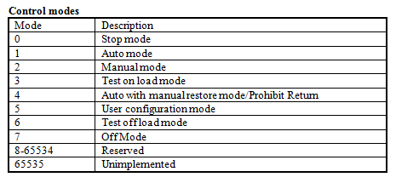
www.deepseaplc.com
Controller Operating Mode
Modbus Page 3, Register Offset 4 contains the module’s operating mode.

Slide 5
www.deepseaplc.com
Engine / Generator Status
Many instruments are available to read from the Gencomm Registers. These registers tell us the exact state of the engine / generator.
However sometimes an application requires to know an ‘overview’ status item.
For example ‘Generator Available’ is often required. This is an overview of the status of a number of parameters within the controller.
A controller Virtual LED,Digital Output or Configurable Gencomm Register can be configured to provide this status item, that itself can be monitored using Gencomm.

Slide 6
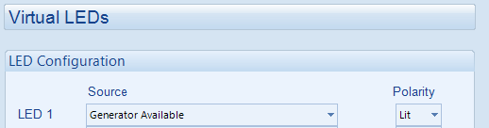
www.deepseaplc.com
Engine / Generator Status
Virtual LED
A virtual LED can be considered the same as a Module LED or Digital Output that has no physical way to manifest itself.
The only way to test it’s status is by using Gencomm.
Example Configure Virtual LED 1 to show Generator Available.

Slide 7
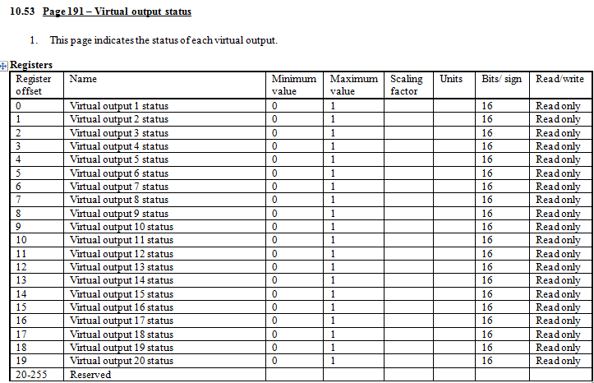
www.deepseaplc.com
Engine / Generator Status
Virtual LED
We read it’s status in Page 191 :

Slide 8
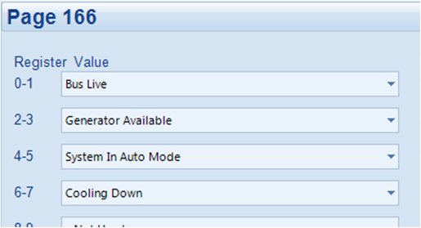
www.deepseaplc.com
Engine / Generator Status
Configurable Gencomm
Configurable Gencomm Pages are used to give a flexible means of providing a contiguous set of registers that can be easily read in a single operation.
Example :

Slide 9
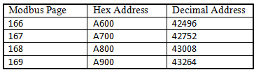
www.deepseaplc.com
Engine / Generator Status
Configurable Gencomm
Depending upon module type, up to four Configurable Gencomm modbus pages are available :

